Slide 1
Number Systems
Nazmun Nessa Moon
Assistant Professor
Department of CSE
Daffodil International University

Slide 2
Learning Objectives
In this lecture you will learn about:
Non-positional number system
Positional number system
Decimal number system
Binary number system
Octal number system
Hexadecimal number system
Convert a number’s base
Another base to decimal base
Decimal base to another base
Some base to another base
Shortcut methods for converting
Binary to octal number
Octal to binary number
Binary to hexadecimal number
Hexadecimal to binary number
Fractional numbers in binary number system

Slide 3
Number Systems
Two types of number systems are:
Non-positional number systems
Positional number systems

Slide 4
Non-positional Number Systems
Characteristics
Use symbols such as I for 1, II for 2, III for 3, IIII for 4, IIIII for 5, etc.
Each symbol represents the same value regardless of its position in the number
The symbols are simply added to find out the value of a particular number
Difficulty
It is difficult to perform arithmetic with such a number system

Slide 5
Positional Number Systems
Characteristics
Use only a few symbols called digits
These symbols represent different values depending on the position they occupy in the number
The value of each digit is determined by
The digit itself
The position of the digit in the number
The base of the number system (base = total number of digits in the number system)
The maximum value of a single digit is always equal to one less than the value of the base

Slide 6
Decimal Number System
Characteristics
A positional number system
Has 10 symbols or digits (0, 1, 2, 3, 4, 5, 6, 7, 8, 9). Hence, its base = 10
The maximum value of a single digit is 9 (one less than the value of the base)
Each position of a digit represents a specific power of the base (10)
We use this number system in our day-to-day life
Example
2586₁₀ = (2 x 10³) + (5 x 10²) + (8 x 10¹) + (6 x 10⁰)
= 2000 + 500 + 80 + 6

Slide 7
Binary Number System
Characteristics
A positional number system
Has only 2 symbols or digits (0 and 1). Hence its base = 2
The maximum value of a single digit is 1 (one less than the value of the base)
Each position of a digit represents a specific power of the base (2)
This number system is used in computers
Example
10101₂ = (1 x 2⁴) + (0 x 2³) + (1 x 2²) + (0 x 2¹) x (1 x 2⁰)
= 16 + 0 + 4 + 0 + 1
= 21₁₀

Slide 8
Bit
Bit stands for binary digit
A bit in computer terminology means either a 0 or a 1
A binary number consisting of n bits is called an n-bit number

Slide 9
Representing Numbers in Different Number Systems
In order to be specific about which number system we are referring to, it is a common practice to indicate the base as a subscript.
Thus, we write: 10101₂ = 21₁₀

Slide 10
Octal Number System
Characteristics
A positional number system
Has total 8 symbols or digits (0, 1, 2, 3, 4, 5, 6, 7).
Hence, its base = 8
The maximum value of a single digit is 7 (one less than the value of the base)
Each position of a digit represents a specific power of the base (8)
Since there are only 8 digits, 3 bits (2³ = 8) are sufficient to represent any octal number in binary
Example
2057₈ = (2 x 8³) + (0 x 8²) + (5 x 8¹) + (7 x 8⁰)
= 1024 + 0 + 40 + 7
= 1071₁₀

Slide 11
Hexadecimal Number System
Characteristics
A positional number system
Has total 16 symbols or digits (0, 1, 2, 3, 4, 5, 6, 7, 8, 9, A, B, C, D, E, F). Hence its base = 16
The symbols A, B, C, D, E and F represent the decimal values 10, 11, 12, 13, 14 and 15 respectively
The maximum value of a single digit is 15 (one less than the value of the base)
Each position of a digit represents a specific power of the base (16)
Since there are only 16 digits, 4 bits (2⁴ = 16) are sufficient to represent any hexadecimal number in binary
Example
1AF₁₆ = (1 x 16²) + (A x 16¹) + (F x 16⁰)
= 1 x 256 + 10 x 16 + 15 x 1
= 256 + 160 + 15
= 431₁₀

Slide 12
Converting a Number of Another Base to a Decimal Number
Method
Step 1: Determine the column (positional) value of each digit
Step 2: Multiply the obtained column values by the digits in the corresponding columns
Step 3: Calculate the sum of these products

Slide 13
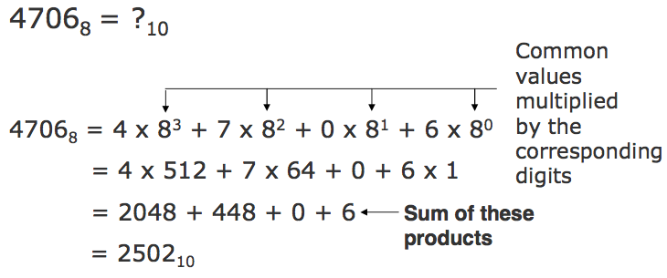
Converting a Number of Another Base to a Decimal Number
Example

Slide 14
Converting a Decimal Number to a Number of Another Base
Division-Remainder Method
Step 1: Divide the decimal number to be converted by the value of the new base
Step 2: Record the remainder from Step 1 as the rightmost digit (least significant digit) of the new base number
Step 3: Divide the quotient of the previous divide by the new base
Step 4: Record the remainder from Step 3 as the next digit (to the left) of the new base number
Repeat Steps 3 and 4, recording remainders from right to left, until the quotient becomes zero in Step 3
Note that the last remainder thus obtained will be the most significant digit (MSD) of the new base number

Slide 15
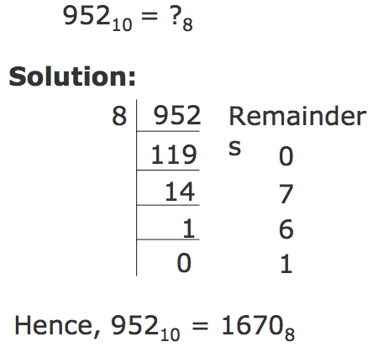
Converting a Decimal Number to a Number of Another Base
Example:

Slide 16
Converting a Number of Some Base to a Number of Another Base
Method
Step 1: Convert the original number to a decimal number (base 10)
Step 2: Convert the decimal number so obtained to the new base number

Slide 17
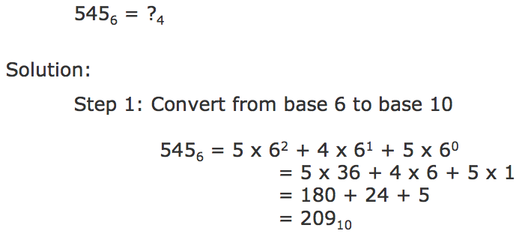
Converting a Number of Some Base to a Number of Another Base
Example:

Slide 18
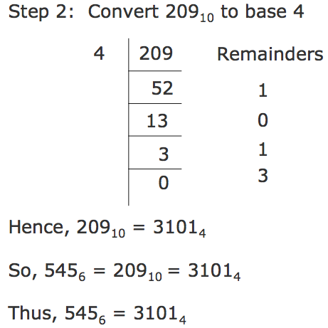
Converting a Number of Some Base to a Number of Another Base

Slide 19
Shortcut Method for Converting a Binary Number to its Equivalent Octal Number
Method
Step 1: Divide the digits into groups of three starting from the right
Step 2: Convert each group of three binary digits to one octal digit using the method of binary to decimal conversion

Slide 20
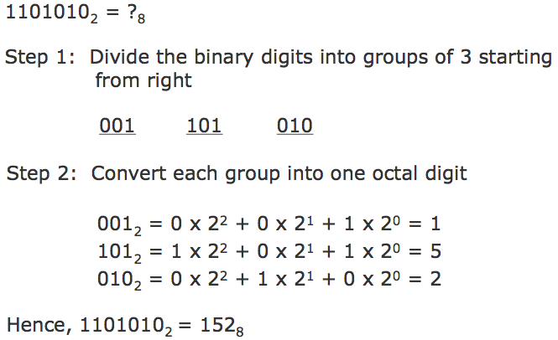
Shortcut Method for Converting a Binary Number to its Equivalent Octal Number
Example:

Slide 21
Shortcut Method for Converting an Octal Number to Its Equivalent Binary Number
Method
Step 1: Convert each octal digit to a 3 digit binary number (the octal digits may be treated as decimal for this conversion)
Step 2: Combine all the resulting binary groups (of 3 digits each) into a single binary number

Slide 22
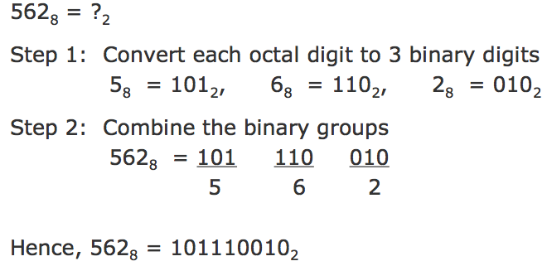
Shortcut Method for Converting an Octal Number to Its Equivalent Binary Number
Example:

Slide 23
Shortcut Method for Converting a Binary Number to its Equivalent Hexadecimal Number
Method
Step 1: Divide the binary digits into groups of four starting from the right
Step 2: Combine each group of four binary digits to one hexadecimal digit

Slide 24
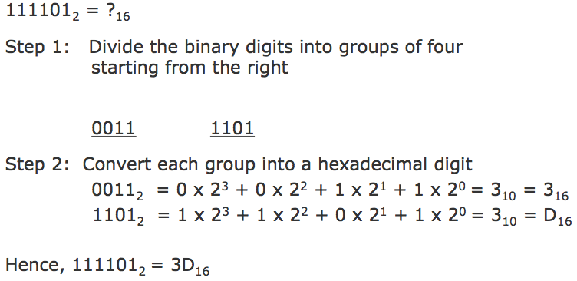
Shortcut Method for Converting a Binary Number to its Equivalent Hexadecimal Number
Example:

Slide 25
Shortcut Method for Converting an Octal Number to Its Equivalent Binary Number
Method
Step 1: Convert each octal digit to a 3 digit binary number (the octal digits may be treated as decimal for this conversion)
Step 2: Combine all the resulting binary groups (of 3 digits each) into a single binary number

Slide 26
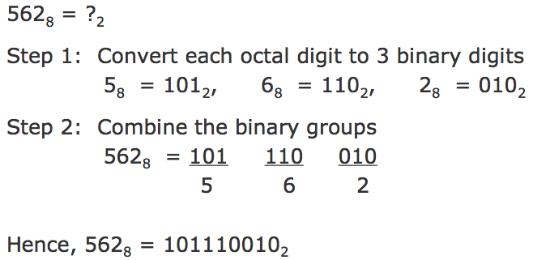
Shortcut Method for Converting an Octal Number to Its Equivalent Binary Number
Example:

Slide 27

Shortcut Method for Converting a Binary Number to its Equivalent Hexadecimal Number
Example:

Slide 28
Shortcut Method for Converting a Hexadecimal Number to its Equivalent Binary Number
Method
Step 1: Convert the decimal equivalent of each hexadecimal digit to a 4 digit binary number
Step 2: Combine all the resulting binary groups (of 4 digits each) in a single binary number

Slide 29
Shortcut Method for Converting a Hexadecimal Number to its Equivalent Binary Number
Example: 2AB₁₆ = ?₂
Step 1: Convert each hexadecimal digit to a 4 digit binary number
2₁₆ = 210 = 0010₂
A₁₆ = 1010 = 1010₂
B₁₆ = 1110 = 1011₂
Step 2: Combine the binary groups
2AB₁₆ = 0010 1010 1011
2 A B
Hence, 2AB₁₆ = 001010101011₂

Slide 30
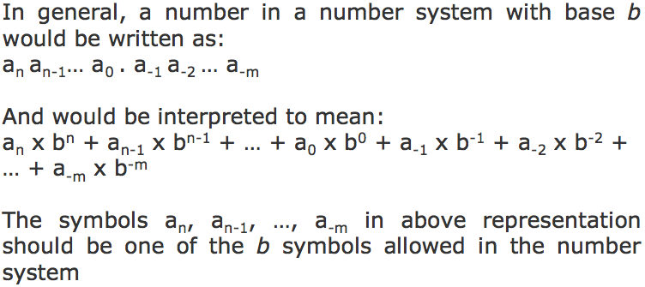
Fractional Numbers
Fractional numbers are formed same way as decimal number system

Slide 31
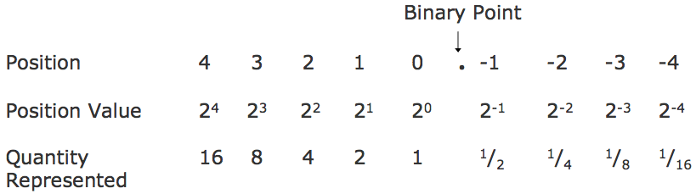
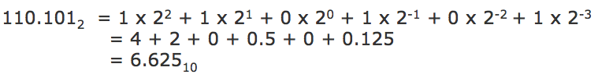
Formation of Fractional Numbers in Binary Number System
Example:

Slide 32
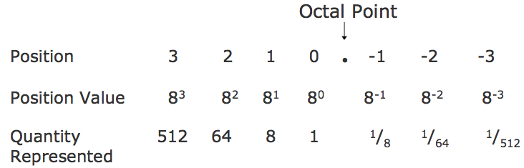
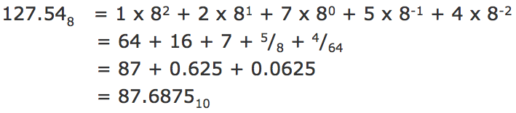
Formation of Fractional Numbers in Octal Number System
Example:

Slide 33
Key Words/Phrases
Base Least Significant Digit (LSD)
Binary number system Memory dump
Binary point Most Significant Digit (MSD)
Bit Non-positional number
Decimal number system system
Division-Remainder technique Number system
Fractional numbers Octal number system
Hexadecimal number system Positional number system

